Slide 1
Urban Centers & Corridors Strategy
Climate Action Steering Committee
September 27, 2021

Slide 2

Thurston Climate Mitigation Plan
Strategy T1: Set land use policies that support increased density and efficient transportation networks and reduce urban sprawl.
Actions to support infill development, dense neighborhoods, and a variety of housing types
Targets:
By 2035, 72% of all (new and existing) households in our cities, towns, and unincorporated urban growth areas will be within a half-mile (comparable to a 20-minute walk) of an urban center, corridor, or neighborhood center.
Between 2010 and 2035, no more than 5% of new housing will locate in the rural area.

Slide 3
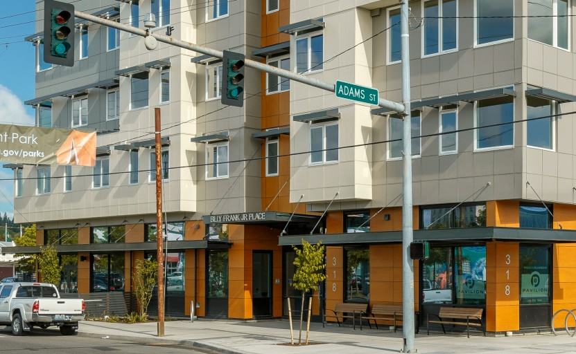
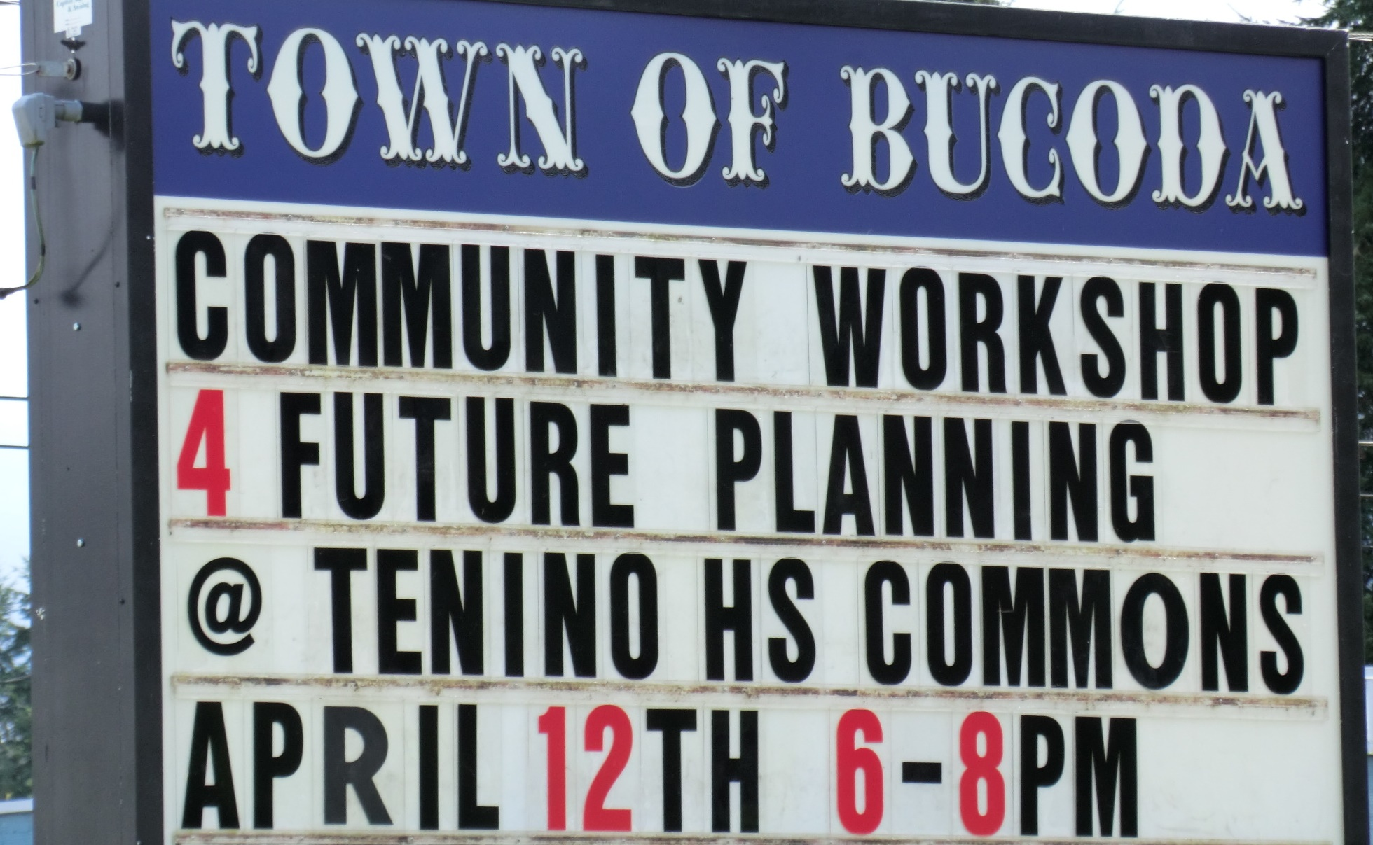
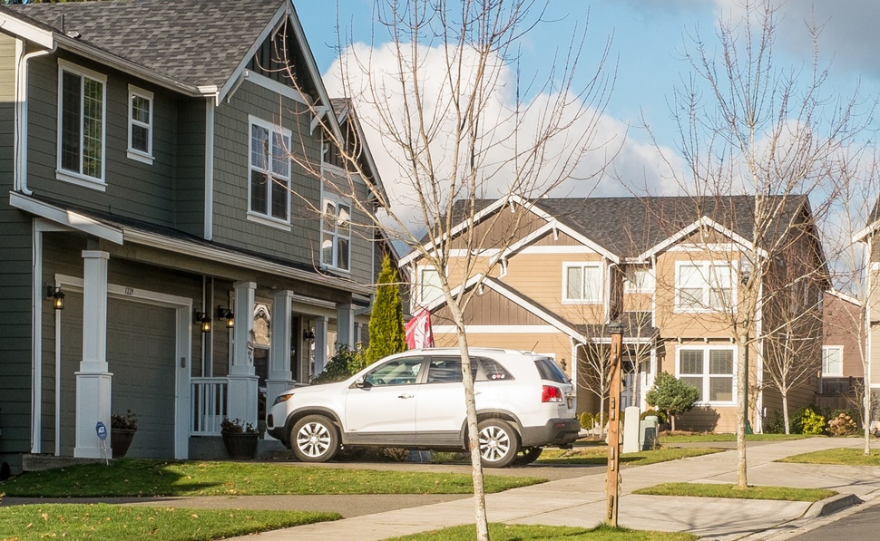
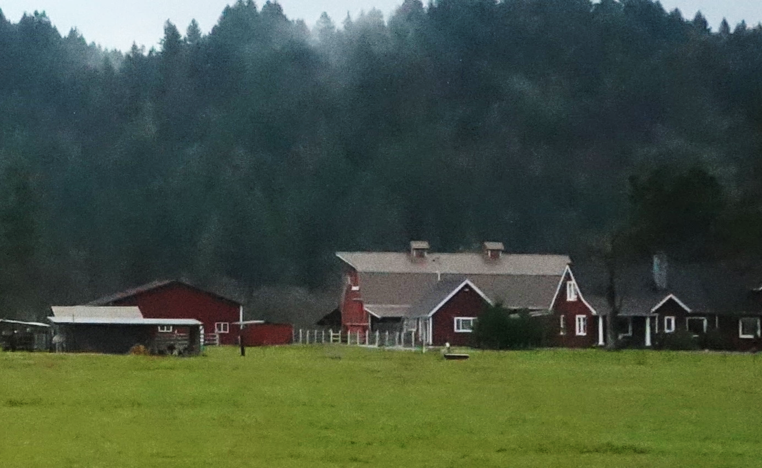
Sustainable Thurston (2013)
How should Thurston County “look, function, and feel” in 2035?
North County Centers & Corridors
South County Communities
Neighborhoods
Rural Lands
Dense neighborhoods where people can live, work, and play without depending on a vehicle
Foster entrepreneur-ship and economic development while maintaining “small town feel”
Areas with a range of housing options centered around neighborhood retail/civic spaces
Preserve rural character and protect critical habitat and resource lands

Slide 4
Urban Centers & Corridors as a Climate Mitigation Strategy
Reduce Emissions
Co-Benefits
Buildings – Reduced residential energy use
Transportation – Vehicle miles traveled (VMT)
Liveability – housing near opportunity
Public health
Economic vitality
Efficient use of public services (fire, medic, police, utilities, road maintenance)
Water use
Impervious surfaces and stormwater
Conservation of rural areas – agriculture, forests, open space
Notes:
By reducing sprawl, adding more housing units, and, ideally, cutting down transit times, building density tackles a key side effect of rising costs: the movement of affordable housing farther away from opportunity.
Increased density means more opportunities for walkable neighborhoods and car-free transit, which would cut pollution. Density means shorter commutes and less driving, leading to less congestion, fewer road fatalities, and improved health outcomes from cleaner air.

Slide 5

Urban Centers & Corridors as a Climate Mitigation Strategy - National
A 1% increase in population density → 0.8% reduction in per capita emissions. ¹
In US cities, if you double the population density:²
35% reduction in energy consumption
48% reduction in emissions from household travel
Compounding effect of density:³
Cities with average density → 10% more compact census tracts = 5% fewer VMT
Cities with higher density → 10% more compact census tracts = 10% fewer VMT
60-90% new urban growth in compact development = 0.2%-4% transportation GHG reduction.⁴
Ribeiro, H.V., Rybski, D. & Kropp, J.P. (2019). Effects of changing population or density on urban carbon dioxide emissions. Nat Commun 10, 3204.
Lee, S., and Lee, B. (2014) The Influence of Urban Form on GHG Emissions in the U.S. Household Sector. Journal of Energy Policy, 68: 534-549.
Lee, S., & Lee, B. (2020). Comparing the impacts of local land use and urban spatial structure on household VMT and GHG emissions. Journal of Transport Geography, 84, [102694].
National Academies of Sciences, Engineering, and Medicine (2012). Practitioners Guide to Incorporating Greenhouse Gas Emissions into the Collaborative Decision-Making Process. Washington, DC: The National Academies Press. https://doi.org/10.17226/22802.
Notes:
By reducing sprawl, adding more housing units, and, ideally, cutting down transit times, building density tackles a key side effect of rising costs: the movement of affordable housing farther away from opportunity.
Increased density means more opportunities for walkable neighborhoods and car-free transit, which would cut pollution. Density means shorter commutes and less driving, leading to less congestion, fewer road fatalities, and improved health outcomes from cleaner air.

Slide 6
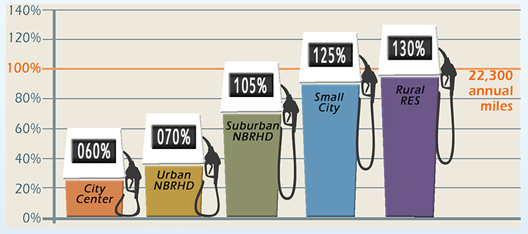
Urban Centers & Corridors as a Climate Mitigation Strategy - Local
Preferred Land Use Scenario
- 28% residential energy use¹
- 11% household water use¹
- 2% vehicle miles traveled²
$1.6 billion savings in road, water, sewer, and other related infrastructure¹
Sustainable Thurston, Preferred Land Use Scenario Key Indicators (2013). https://www.trpc.org/DocumentCenter/View/778/Preferred-Land-Use-Scenario-and-Key-Indicators-PDF . Note: percent reduction compared to 2010 baseline.
Interstate 5: Tumwater to Mounts Road Mid- and Long-Range Strategies Corridor Study Report (2020). https://wsdot.wa.gov/planning/studies/i5/tumwater-mounts-road/home . Note: percent reduction compared to 2040 forecast.
Notes:
By reducing sprawl, adding more housing units, and, ideally, cutting down transit times, building density tackles a key side effect of rising costs: the movement of affordable housing farther away from opportunity.
Increased density means more opportunities for walkable neighborhoods and car-free transit, which would cut pollution. Density means shorter commutes and less driving, leading to less congestion, fewer road fatalities, and improved health outcomes from cleaner air.
- 10% total GHG emissions¹
- 6% VMT reduction in TCMP

Slide 7
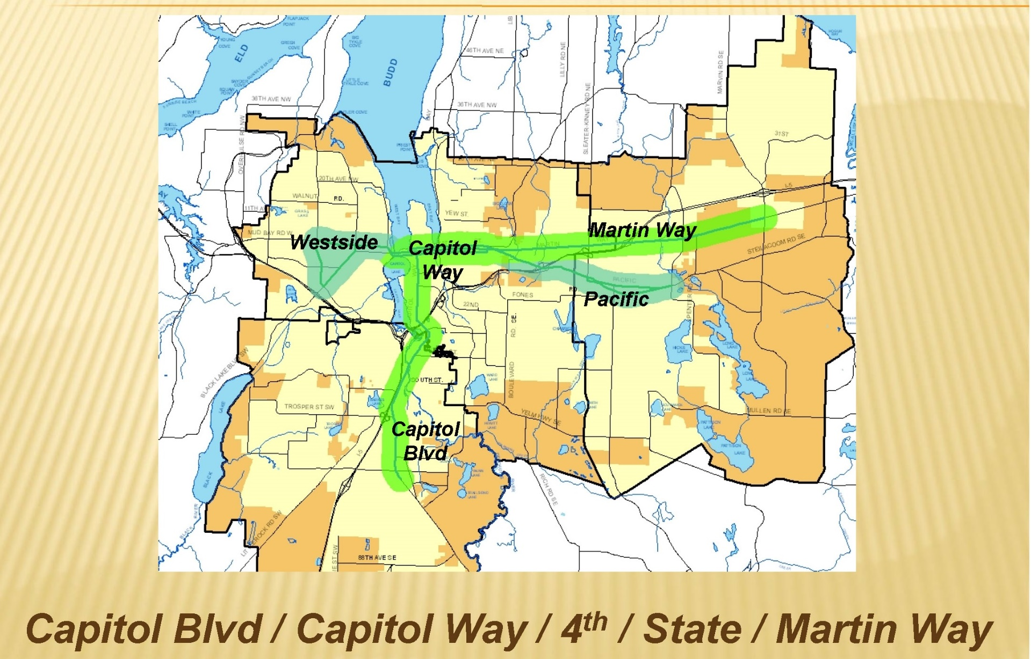
Urban Corridors Task Force (2012)
A joint subcommittee of Thurston Regional Planning Council and its Transportation Policy Board

Slide 8
Urban Corridors Task Force Recommendations
Modest Measures
Augment the status quo
Property Inventory
Education Process
Augment Land Use Analysis
Identify Priority Investment Locations
Moderate Measures
Work strategically within existing framework
Develop Strategic Investment Strategy
Refine Regulatory Tools
Apply Impact Fees Strategically
Develop Land Acquisition Strategy
Evaluate Urban Growth Boundaries
Mighty Measures
Redefine the framework
Legislative Agenda
Community Lending Pool
Urban Corridor Development Partnership

Slide 9
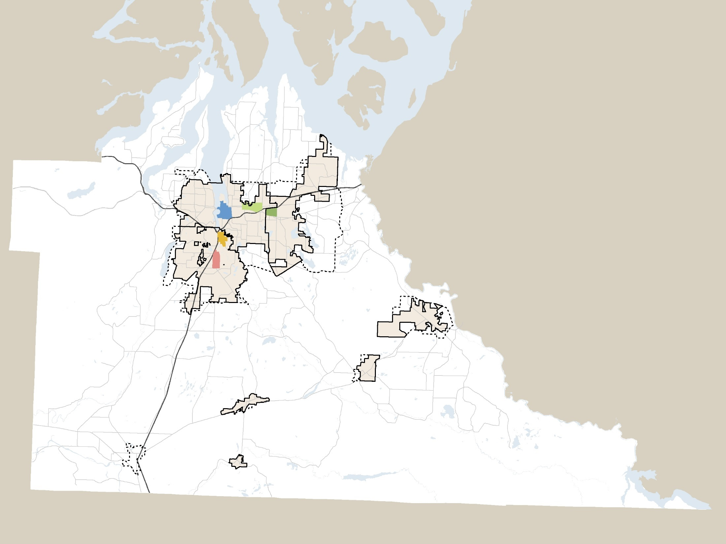
Private & Public Investments 2011-2017
$293 million
Downtown Olympia
$181 million
Martin Way District
$26 million
Woodland District
$36 million
Harrison Corridor
$6 million
Brewery District
$6.7 million
Capitol Corridor
$19 million
Downtown Yelm
$8 million
Rochester / Grand Mound
$10 million
Downtown Rainier
$135,000
Downtown Tenino
> $90,000
Downtown Bucoda
> $42,000
Notes:
K:\GUEST\UrbanCorridors\CorridorsRevisited2017

Slide 10

2021 Buildable Lands Report
Volume I: GMA Goals
Volume II: Regional Goals
Achieved Densities Are we achieving urban-level residential densities in Urban Growth Areas?
Urban Capacity Is there sufficient buildable land in the urban areas to accommodate 20 years of residential and commercial/industrial growth?
Rural Areas Evaluation of rural residential densities
Sustainable Thurston
At least 95% of new housing between 2010 and 2035 in the urban areas
72% of urban area housing within ½ mile of an urban center, urban corridor, or neighborhood center
Notes:
MICHAEL

Slide 11
Sustainable Thurston Target 1
Target
At least 95% of new housing between 2010 and 2035 in the urban areas
Notes:
ALLISON

Slide 12
Sustainable Thurston Target 2
Target
By 2035, 72% of all households in our urban areas will be within a half-mile of an urban center, corridor, or neighborhood center with access to goods and services to meet some of their daily needs.
Notes:
ALLISON

Slide 13
Land Use Alternative
What if…
More housing in our urban areas | Higher densities in downtowns & along urban corridors | Neighborhood centers that better served nearby residents | Preserved our farm and timberland
Notes:
MICHAEL

Slide 14
Sustainable Thurston Target 1 At least 95% of new housing between 2010 and 2035 in the urban areas
Strategies could get us within 1% of target

Slide 15
Sustainable Thurston Target 2 72% of urban area growth within ½ mile of an urban center, urban corridor, or neighborhood center
Strategies could get us within 6% of target

Slide 16
Why aren’t we on track?
We are making progress…
1990-2014 – 6% of all development in a center/corridor
2015-2020 – 32% of all development in a center/corridor
Not all development between 2010 and 2020 has been consistent with Sustainable Thurston goals
Cities have made changes to development regulations, but it takes time to see the effects
Model shows that recent changes will get us closer to meeting our targets, but not all the way there.
Notes:
Development in downtowns and corridors offset by housing elsewhere in the urban areas
Silver Hawk subdivision
Model was updated to address recent development reg/development pattern changes. Improved the outlook but did not get us all the way there.

Slide 17
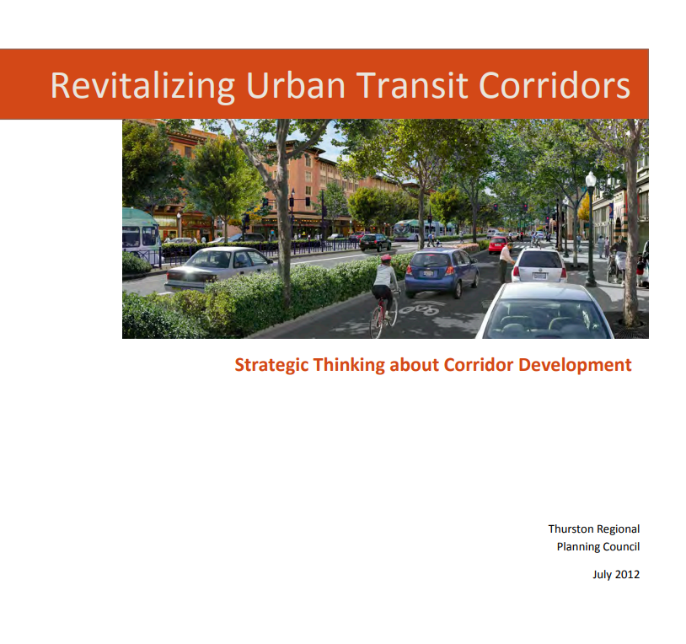
Strategies Discussion
“Adopted land use and transportation plans envision the emergence of dynamic urban centers offering an array of ‘car-lite’ lifestyle choices not currently available in Thurston County. This is an ambitious goal for a region of our size. Achieving this takes more than vision and regulations. It takes proactive, strategic measures on the part of local governments, and new public/private partnerships. It requires new ways of thinking about the value of urban investments and development, and that takes political leadership and courage. It will take bold measures to make our urban vision real.”
- Urban Corridors Task Force, 2012
Notes:
“Government must be a more effective community development partner if this region’s urban vision is to be realized.”

Slide 18
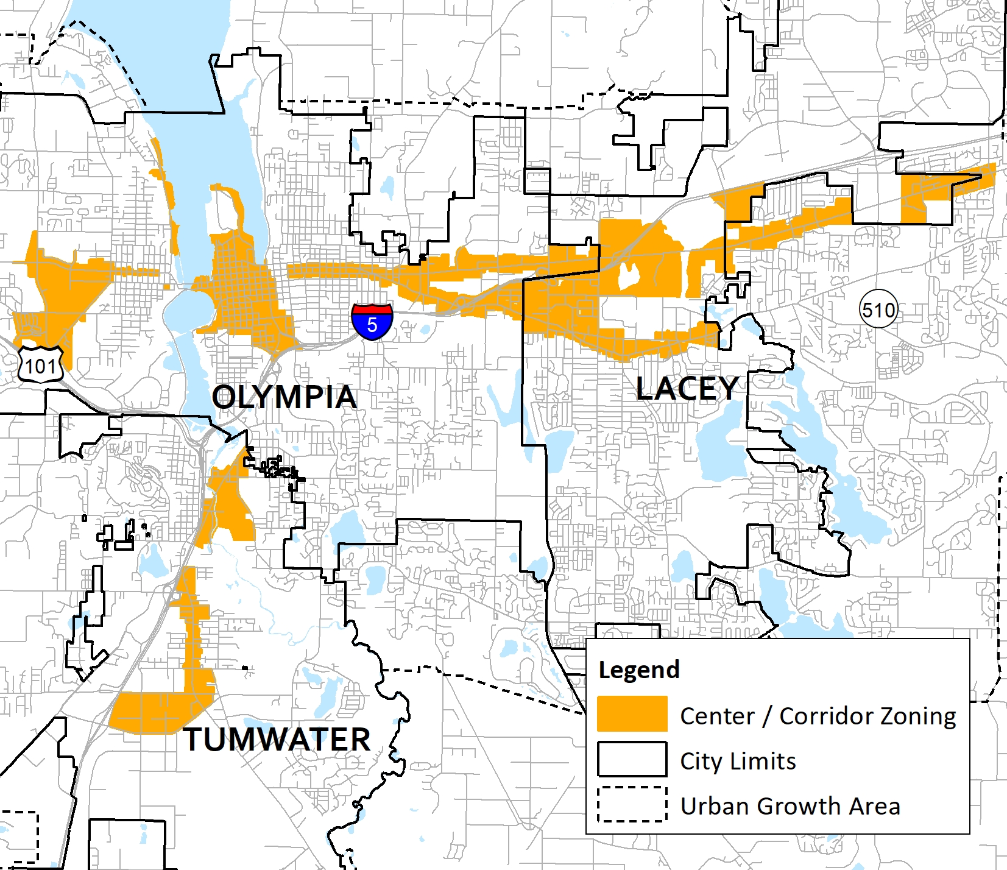
Recommendations Urban Centers & Corridors
Continue to increase residential development in city centers.
Increase the amount of residential development in mixed use zones along corridors.
Create incentives for redevelopment at key “opportunity sites” located along corridors.
Review, and if necessary update, urban corridor boundaries.

Slide 19
How can we better connect climate and urban corridor strategies?
Opportunities
Corridor Plans (ex., Martin Way Corridor Study)
Comprehensive Plan updates
Development codes
Land use and transportation decisions

